Slide 1

COVID-19 Google Search Trends

Slide 2
Interest By Region Data

Slide 3
Interest By Time Data

Slide 4
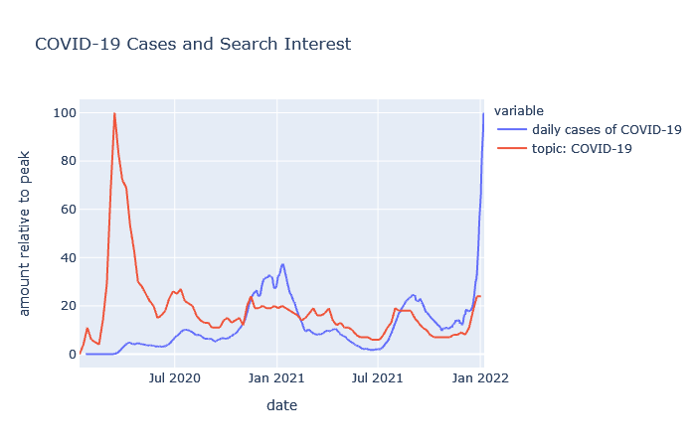
Searches on COVID-19
early pandemic there is understandably a high spike in searches on COVID-19
increase in searches correspond to increase in cases

Slide 5
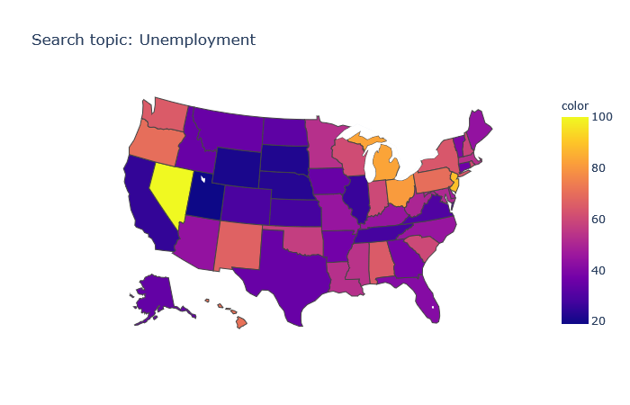
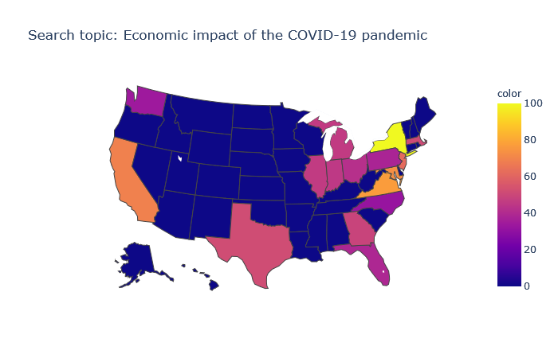
Regional concern about economy during the pandemic

Slide 6
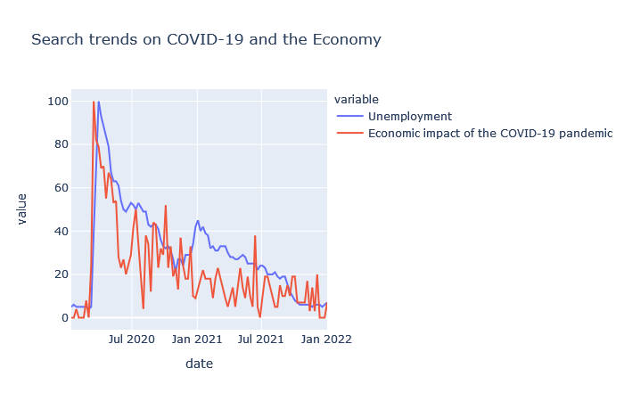
Economic concerns over time
overall concern spiked early in the pandemic and has gone down since
spike in unemployment searches during the upsurge in cases last winter
look into actual unemployment data to compare concern vs. real unemployment rates

Slide 7
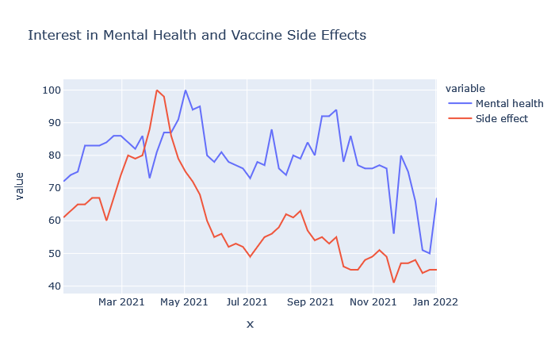
Mental health and vaccine perceptions
increase in searches about mental health seem to occur at the same time as increase in searches about vaccine side effects
can look into regression

Slide 8
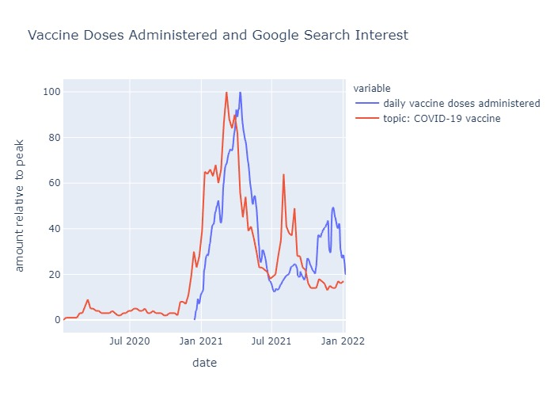
Using Google Trends to Predict Vaccination Spikes
combined Google Trends data with CDC data
clear delay between spike in searches on the vaccine and vaccinations
use search trends to predict when higher number of vaccines will need to be distributed

Slide 9
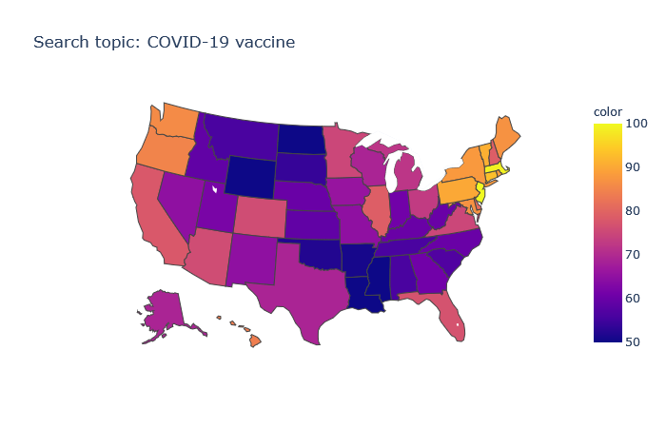
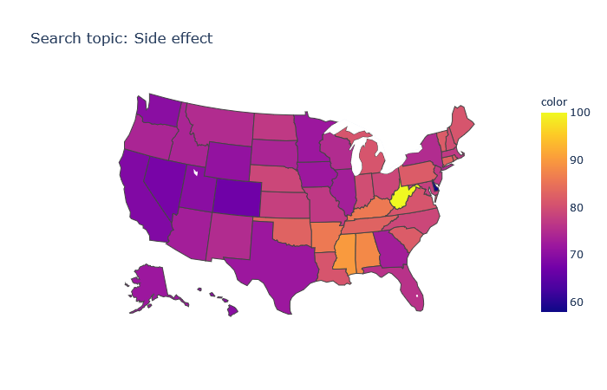
Targeted advertising/educating on vaccine risks

